Slide 1
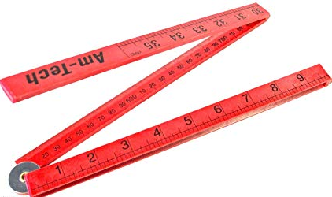
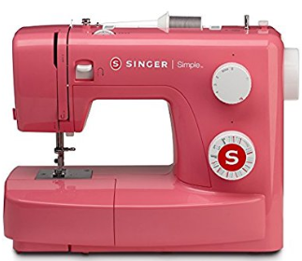

A meter, a sewing machine and pair of scissors
(A history about Threat Modeling in Software)
Madrid 30/01/2019 Daniel Martínez

Slide 2
Index
1. Storyteller
4. ¡Demo time!
6. Questions and propositions?
5. Risks and some conclussions
2. I want to live quiet and calm
3. Modeling, what??

Slide 3

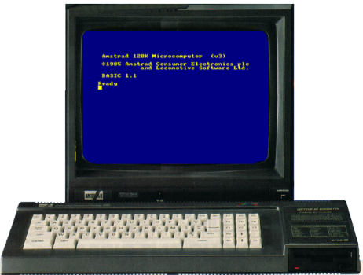
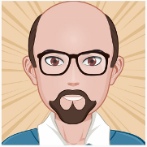
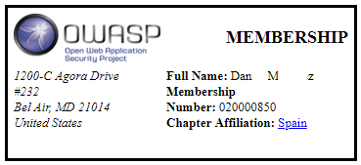


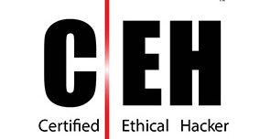
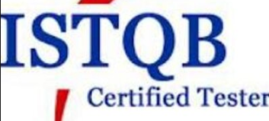
Storyteller @foyde foy555@gmail.com
Began with:
Software Security Assessments and Static code analysis (practices too)
Not so good with PPTs !!

Slide 4
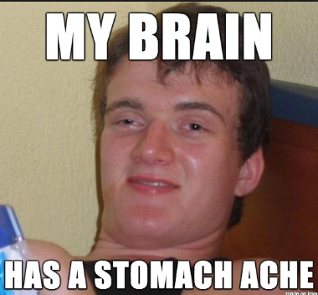

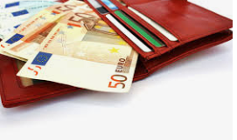
What is a vulnerability?
.
I want to live quiet and calm
Possible weakness in our application that allows a malicious agent to take advantage of it (Def: myself)
The greater the value of the vulnerable asset (or assets) and the more frequent this threat occurs, the greater the risk to the business that our application represents
Better explained:

Slide 5
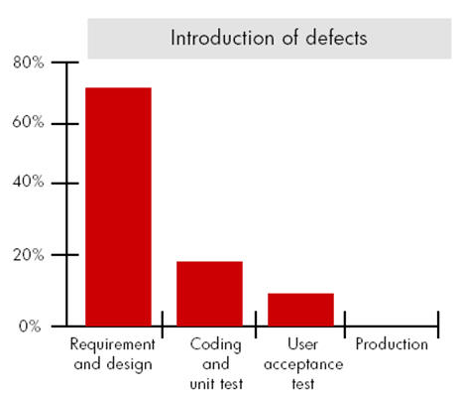
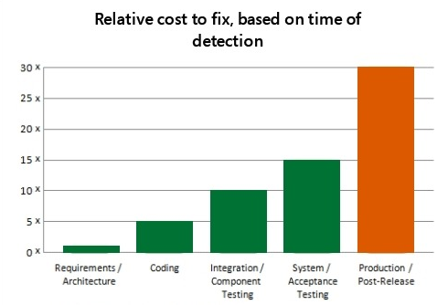
How much $$$ are we talking about?
I want to live quiet and calm
The requirement gathering and design phases are the most favourable to introduce new defects and security problems. In contrast, the average cost of the repair during these initial phases is up to 30 times less than in the production phase. Source: NIST (https://www.nist.gov/ )

Slide 6


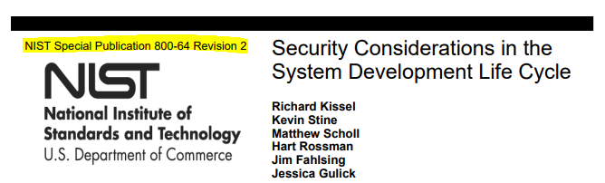

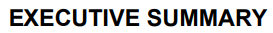
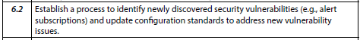
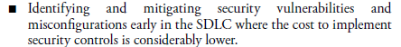
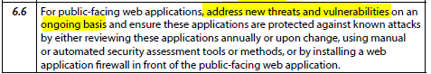
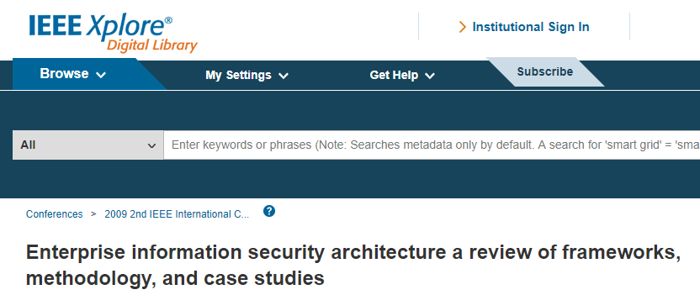
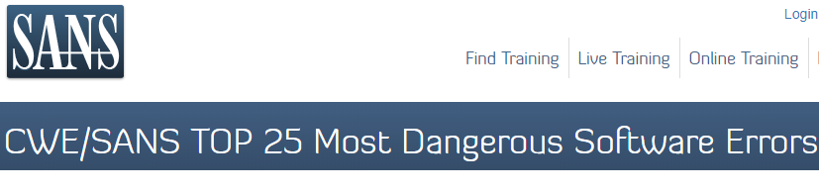
What about the industry?
What model and what for?
https://ieeexplore.ieee.org/abstract/document/5234695
https://www.sans.org/top25-software-errors

Slide 7
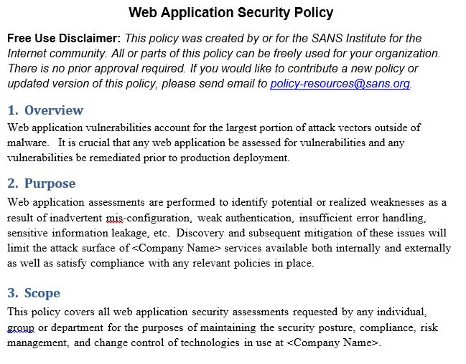
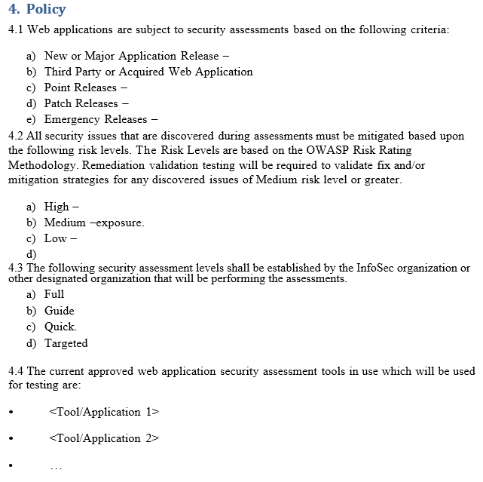
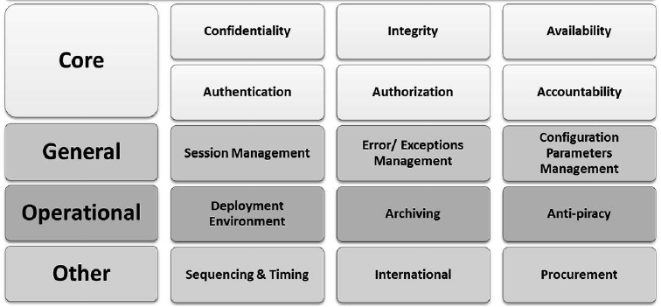
And your corporate policies?
What model and what for?
Talk to your Management and business división
Talk to your CIO/CISO
Establish a (risk based) starting point for your SDLC
Security effort = Standarized Requirements
←

Slide 8
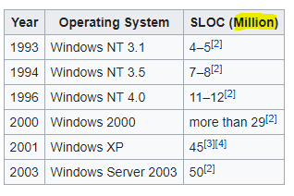
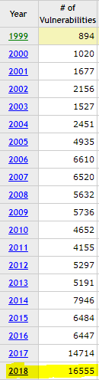
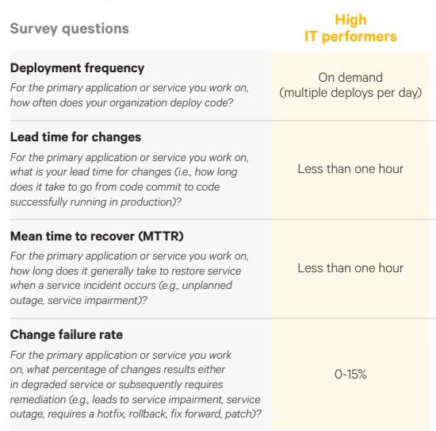

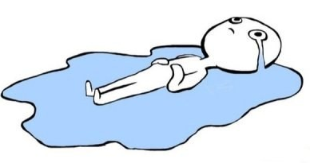
What model and what for?
Source: Wikipedia Source:Wikipedia
https://www.cvedetails.com/browse-by-date.php
https://www.netsolutions.com/insights/why-do-great-product-companies-release-software-to-production-multiple-times-a-day/
The real world: ↑codeplexity ↑security ↓time

Slide 9

HELP!
What model and what for?

Slide 10
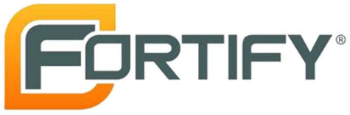
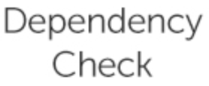


What model and what for?
The App security traditional toolkit

Slide 11
Good tools and tricks, but….
What model and what for?
“I can not determine the risk of my application or my users”
“I do not know what some are for, some are $$$ and I do not know how to request others”
“False positives or vulnerabilities "do not belong to me" ”
“The results are difficult to understand”
“I can not move it in a practical way to my project. I have a lack of "detail" ”
“How do I fix it? How do we work on that solution? ”
SECURITY guys: not so mature tools sometimes ….
What if we could avoid (almost) all this?

Slide 12
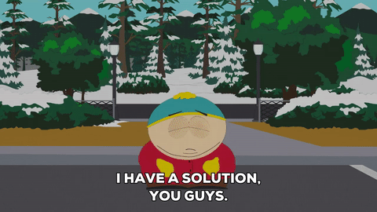
What model and what for?

Slide 13

Day 0 solutions:
What model and what for?
Client, Design, Architectures, Development Teams and Operations hand on hand
Oh yes, its about Risk (Use Vs Abuse cases)
Presentation and language; Explain humble and…
Clearly establish the security requirements for OUR application (Acceptance criteria)
Of all kind of colors and flavors ... Web and mobile application, Waterfall / Agile methodologies, Intranet or Internet, "new" and legacy Apps. Everybody is welcome
Follow up: Learning process and Feedback (In both directions)

Slide 14
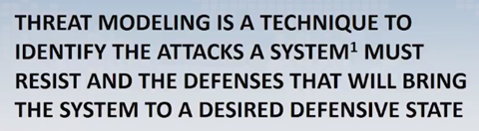
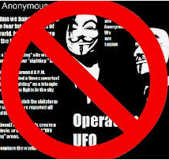

What is a Threat Model?
What model and what for?
√ Structural analysis
√ Review of design elements
√ Priorities according to risk
√ A way to understand ...
(Do not stereotype, please.)

Slide 15
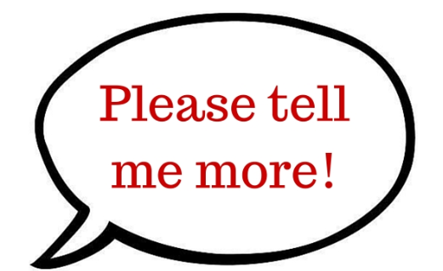
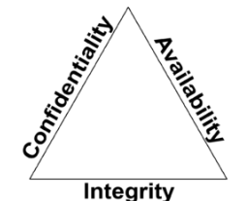
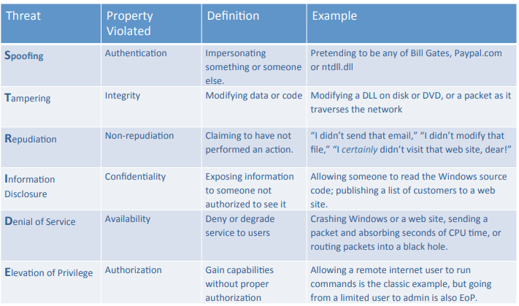
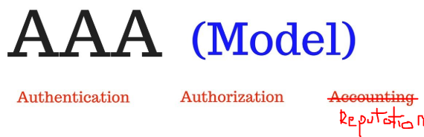
Modeling according to risk?
What model and what for?
+
+

Slide 16


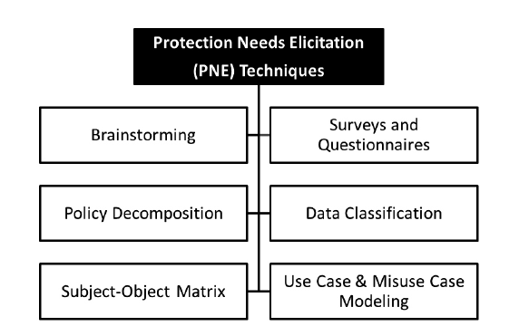
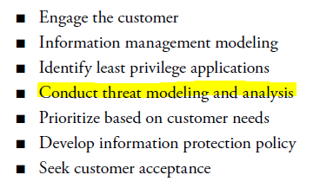
How can we do it?
What model and what for?
Principle needed: PNE (Protection Needs Elicitation):
Determination of Security Requirements a.k.a security people do not have all the answers or security guys deliver the weapons
Costumer based: Engaging Acceptance

Slide 17
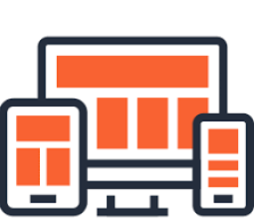
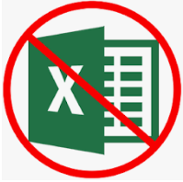

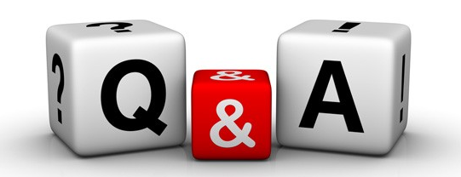
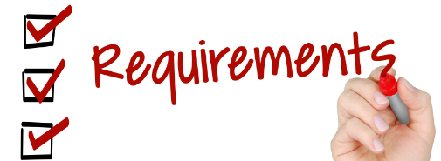
How can we build it? (Its the 2019 folks!))
What model and what for?

Slide 18
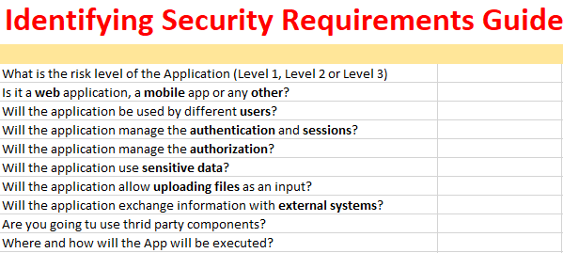
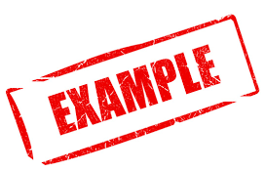
What model and what for?
No more than 10 or 15 questions
Business Risk, Technical & Operational risk
CIA + AAA of OUR App

Slide 19
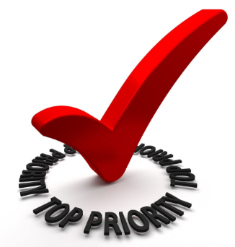
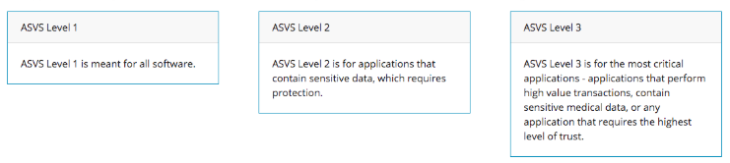
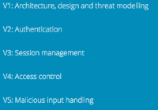
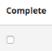
What model and what for?
The OWASP Application Security Verification Standard (ASVS) project provides a basis for testing the technical security controls of web applications and a list of requirements for secure development. Although version 3.01 is the official version at this time, check out the immenent version 4
3 verification levels x risk
Per family requirements (19)
Completion and compliance
https://www.owasp.org/index.php/Category:OWASP_Application_Security_Verification_Standard_Project
https://www.owasp.org/index.php/Category:OWASP_Application_Security_Verification_Standard_Project

Slide 20
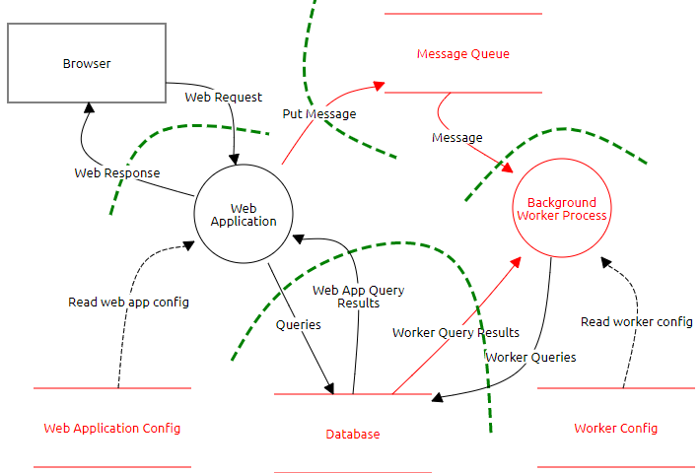
What model and what for?
Three steps: We start by drawing the components of our App and observe how they relate to each other. We determine possible threats from that diagram (physical and logical topology) with:
Services, ports and protocols
Identities, Authentication and Authorization
Actors, Dependencies&Flows, Trust levels
Data inputs and outputs
Network boundaries
Eyes on ->> The greater detail, the better!

Slide 21

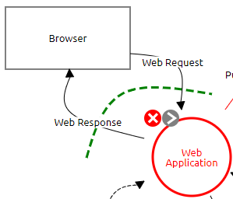

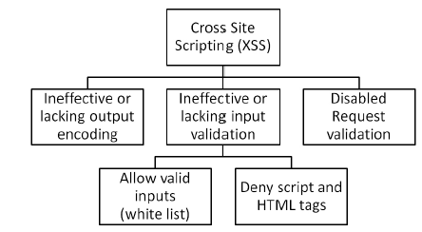
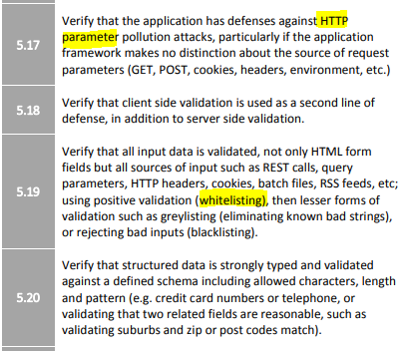




What model and what for?
Determine the threats in our App, establish possible attack patterns and compare them with our requirements -> Know & prevent for the future
ALERT Possible XSS in Design, but HOW?

Slide 22




What model and what for?
Finally, we document our threat profile in a matrix, and build our application PRIORIZING our actions in the rest of life cycle, establishing the Security Risk Assessment (SRA) of our application
Start small and by the most critical parts
Vulns, but design and behavioral flaws too
Priorities (Business Probability X Impact)!
Achievement unlocked: live a little quieter
(Easy right?: Have to work to define and fit all these pieces together ….)

Slide 23







All conected
What model and what for?
In a nutshell, we create user stories with Security requirements from ASVS -> Definition of done:
Integrable model: Visibility throughout the SDLC: Good vs Evil with "auto" testing
"Gaps" in controls that allow us to offer a better response
Discussion and different PoVs. Learning together
Continuous improvement: Quality for the

Slide 24

Demo time!

Slide 25

Risk and conclusions
Risks (or work to do…)
Big project: Sponsor, strategy and "corporate vision" GOVERN
Everybody IN (legislation, compliance), environments and architectures (APIs, Cloud) GLOBAL
Integration within the projects and methodologies (From legacy to agile) IMPACT
A little patience: Medium-term benefits TIME
O P E N TOOLS&MINDSET
Work together cause Security is for hackers everybody COMUNICATION
Defining Roles and Responsibilities: Who defines risk? How do we establish our risk? How is it validated? Auditing and accountability how? PROCESSES&PEOPLE

Slide 26
Risk and conclusions
Conclusions
Threat modeling has to do with security, but above all with BUSINESS
We reduce costs, risk and HELP our Developers to build a safer environment
Ease to use, accessible and transparent = USEFUL. Build the threat model that your projects need
Scalable solutions to better UNDERSTAND and anticipate all the security problems of MY application within a CULTURE ….

Slide 27
….cause
Do you think threat modeling has more to do with a global risk model and culture or with preventing vulnerabilities in your application?

Slide 28

Risk and conclusions
….What if we get on with it?
What are your experiences (and frustrations) with all this?

Slide 29
Appendix: Links
What is IT Security Software? Analysis of Features, Benefits and Pricing: https://financesonline.com/security-software-analysis-features-benefits-pricing/
Capturing security requirements for software systems: https://www.sciencedirect.com/science/article/pii/S2090123214000332
Owasp ASVS 4.0: https://github.com/OWASP/ASVS/tree/master/4.0
What is Threat Modeling? https://en.wikipedia.org/wiki/Threat_model
NIST SP 800-64 Rev. 2: Security Considerations in the System Development Life Cycle: https://csrc.nist.gov/publications/detail/sp/800-64/rev-2/final
Risk analysis in Software Design: https://ieeexplore.ieee.org/abstract/document/1324606
[Book] Use Cases: Requirements in Context, 2nd Edition: https://www.pearson.com/us/higher-education/program/Kulak-Use-Cases-Requirements-in-Context-2nd-Edition/PGM261849.html
[Video] Threat modeling at speed & scale - DevSecCon London 2018: https://www.youtube.com/watch?v=5jyL-CHib54
[Game] Elevation of Privilege (EoP) Card Game: https://www.microsoft.com/en-us/SDL/adopt/eop.aspx

Slide 30

Disclaimer: All logos and trademarks displayed in the presentation are the property of their respective owners. The purpose of this presentation is purely academic and without any commercial sense. Any problem in this sense contact me at the email reference
Madrid 30/01/2019 Daniel Martínez

